Slide 1
(DO NOT SHOW) Migrating Web Applications to Azure
Baseline Event | Microsoft Azure Training Day: Migrating applications to the cloud
Recommended Speaker Roles | Field Technical Roles: Regional CDA’/CSA’s, PFE, GBB’s, MVP, MTC TSP’s
Audience | 70% Developers 30% Architects
Length & Version | 60min
Content Level | 300
Deck Contacts | Mark Winters
Training Resources | Session Video -Video 1 Github resource to run the demo’s-Session 1
Accessibility checker | (date)
CHANGE TRACKER
Date | Slide | Description of Update

Slide 2
Microsoft Azure Training Day:
Introduction to Cloud Applications and Azure

Slide 3
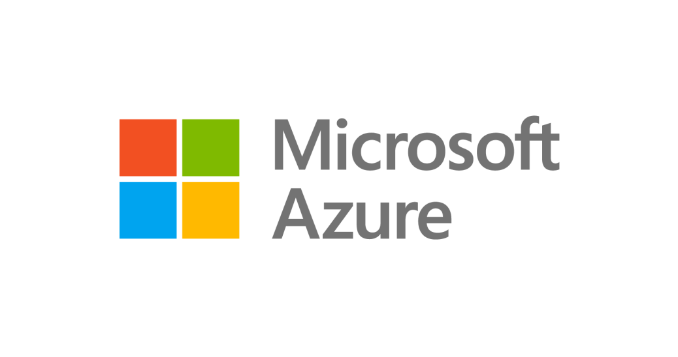
Goals for this session
Migrate a Datacenter hosted app to Azure.
Review available endpoints for migration.
Modernize operational tasks with Azure.
Hands-on experience migrating an app to Azure!
You can download the app here to follow along.
http://aka.ms/migrateyourapps
Notes:
Lets talk a bit about what we’re going to accomplish today – we’ll discuss why you’d want to move a datacenter hosted app into Azure
We’ll review available endpoints for migration on Azure
We’ll discuss the operational work you’ll no longer need to concern yourself with as you modernize your app infrastructure in Azure
And finally we’ll demo the process and show you the application back in production.

Slide 4
Where are your applications?
Notes:
(ASK CROWD)
Where are your applications? (PAUSE FOR EFFECT)
I mean literally – where are they? Where are they physically located right now?
Are they all in your datacenter? How many are in another datacenter or being run by a partner org?

Slide 5


Notes:
On a server. In a data center.
(ASK CROWD)
Raise your hand if you or the place you work is still hosting applications in their own data center.
A lot of folks. And it probably isn’t as nice as this one, is it?
Maybe it looks more like this…

Slide 6
Notes:
YIKES. This probably hits a little too close to home for some people in this room. I know I’ve worked at places that weren’t a far cry from this.
So this is where many of us are hosting our apps.
Why?
It’s 2018! The cloud is here and it is AWESOME.
I get it – applications have been around for a long time and everyone is afraid to touch them. But there are some serious – and I mean SERIOUS benefits to moving to the cloud.
That means there are some serious drawbacks to keeping your apps in your own data center.

Slide 7
Drawbacks to your datacenter hosted application.
Physical infrastructure requires large Capital Expenditure.
You are essentially assuming scale with static hardware.
Expensive compliance requirements.
There are countless reasons to move to “the cloud” but scale, security and cashflow tend to be leaders.
Notes:
I look at remaining in the datacenter as kind of being “stuck in the middle” – you’re making decisions without having data provided to you

Slide 8
Benefits hosting in Azure
No more hardware to manage
Always up to date
Flexible costs
Faster deployment
You can keep your cute server names
Harry
Hermione
Ron
Notes:
Giving servers names is like giving a pet a name, but lets be honest, Harry here cant and wont love you back – Harry’s only going to do what you tell it to. There’s no reason to make attachments to hardware, we’re building an app not running a zoo so let's not name things. They’re cattle, not pets.
BUT, you can even keep your cute server names if you want to. You don’t have to give up your Harry Potter obsession for the cloud.
You can also get rid of your servers entirely like throwing out an old t-shirt. Some old t-shirts aren’t event meant to be repurposed ☺

Slide 9
To the cloud!
Get out of the business of herding hardware and operating systems so you can focus on business growth, agility and your customers.
That’s what you’re really after in the end, isn’t it?
Harry
Ron
Harry
Hermione
Ron
Notes:
The benefits of moving to the cloud are clear – the ability to modify, scale and reduce your architecture on demand.
Let’s walk through how we can get the process started and all the benefits you’ll get from moving your datacenter hosted application to the cloud.

Slide 10

Time to Migrate
But first, some breaking news...
Notes:
This is the setup the setup to begin laying out the storyline for the migration.

Slide 11
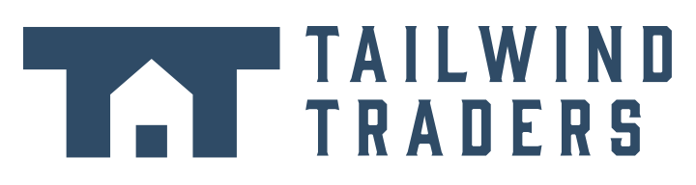
THE DAILY NEWS
theuselessweb.com
THE WORLD’S MOST MEH NEWSPAPER
- Since 5 seconds ago
Tailwind Traders Acquires Northwind
REDMOND, WA - Tailwind Traders, Inc announced that it has agreed to acquire Northwind Traders, the venerable "old guard" international foods company, in an effort to bolster its virtual hardware offerings with some international culinary flare. Tailwind agreed to acquire Northwind for an undisclosed sum and is assuming control of all of Northwind's virtual assets, not excluding the company's flagship product: Aniseed Syrup/
"This is a profoundly wonderful development for
for all involved, and will help to bring our food products to a whole new sector of the market" stated Nancy Daviolo, Executive Vice President of Operations. "We really couldn't be happier with the arrangement". The recently-promoted Daviolo will join the Tailwind executive team along with two of her close associates, Margaret Peacock and Michael Suyama. Daviolo took over Northwind’s company sales operations in 2012 after Andrew Fuller was
Continued on page 8
Notes:
Tailwind Traders has acquired Northwind. Try not to be audibly shocked. Tailwind Traders is now the biggest fake company since By And Large from the movie Wall-e.
And with that acquisition, Tailwind Traders has also acquired even more technical debt. They are now looking to get out of the business of running their own data center, and they are starting to devise a plan to move their legacy applications to the cloud.
One of their most used applications is their Inventory Management system.

Slide 12
Anybody have one of these?
Notes:
Who here recognizes this?
This is Northwind. Northwind has been around for a long time, and if you’ve been a Microsoft developer, you know Northwind very, very well.
Well, we’ve got some big news…a

Slide 13
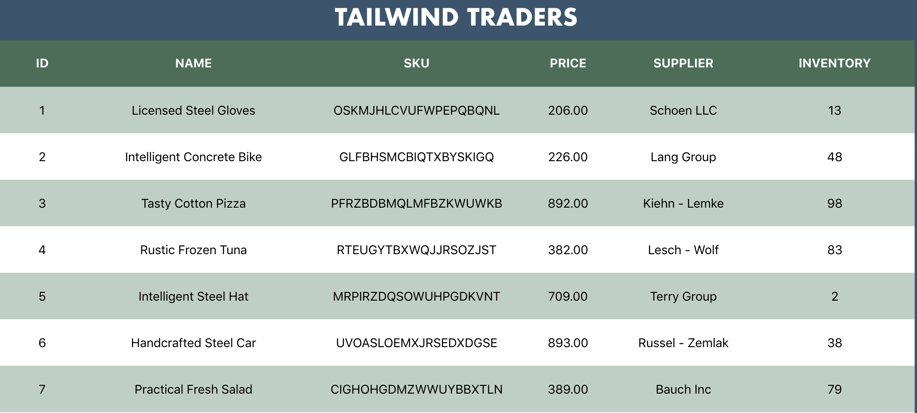
Tailwind Traders Application – Inventory System
Notes:
The Inventory Management system is like a lot of legacy applications. It is a front-end that hides an underlying collection of technologies.
The frontend has been redone fairly recently as a React application (Show running frontend - https://lp2s1frontend.z22.web.core.windows.net/ or click on grid in )
The frontend hides the mess. The mess is composed of two different API’s that are running on different technology stacks and talking to two different databases.
The products that you see here in the grid are served up by a Node.js API that talks to a Mongo DB database. Tailwind got in on the NoSQL revolution a few years back and has had their main product system on Mongo ever since.

Slide 14
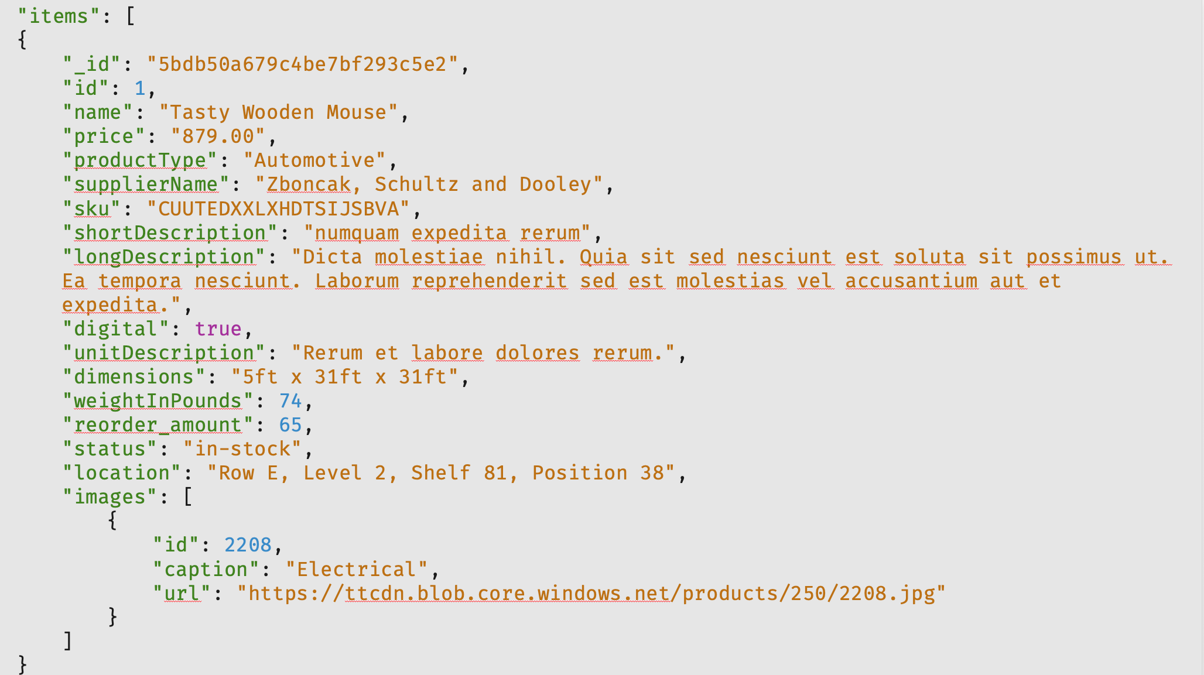
Notes:
Tailwind got in on the NoSQL revolution a few years back and has had their main product system on Mongo ever since.
Each product is delivered by a Node.js service that reads from a Mongo DB database. This is an example of what the Products API looks like. Who doesn’t want to buy a ”Tasty Wooden Mouse”?
(Show the service in the browser. https://lp2s1-product-service.azurewebsites.net/api/products or click on slide to open)

Slide 15
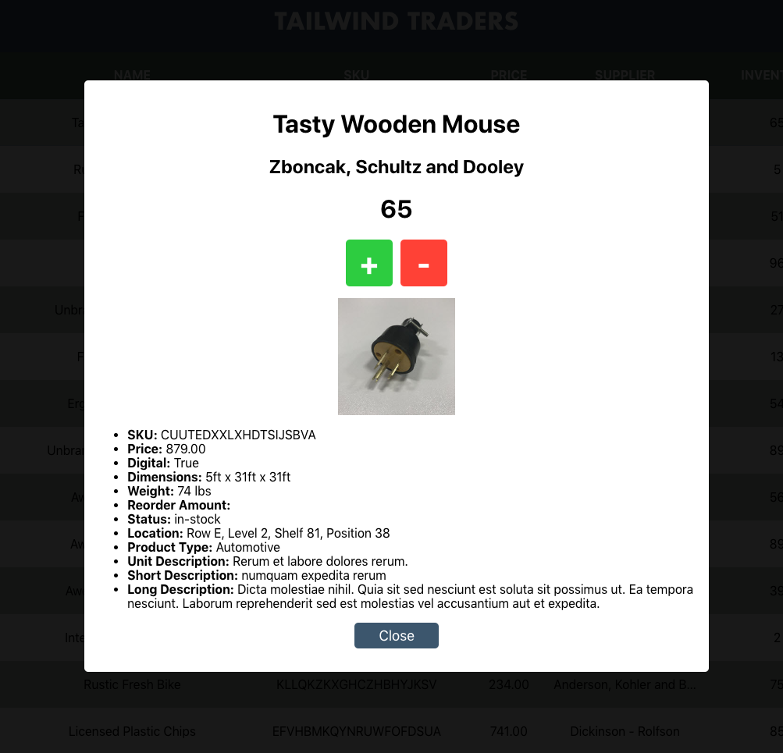
Tailwind Traders Inventory System Detail View
Notes:
When you click on a product, you can manage the quantity of the inventory for that item. Obviously plus and minus buttons are the best possible user interface for changing the quantity of an item. Tailwind doesn’t have an UX experts.
The inventory data is stored in a relational SQL Server/PostgreSQL database. There is a separate API that the frontend talks to for this data. This service is an ASP.NET Core service.
The service also uses Swagger. Anyone here ever heard of Swagger? (Open Inventory Swagger interface - https://lp2s1-inventory-service.azurewebsites.net/swagger or click on slide)
Some developer convinced a manager somewhere that was the right thing to do and they should standardize on it. So they did it for this API, but they never standardized. Sound familiar? Yes, this is unfortunately how the real world works.

Slide 16
A Peek Inside Tailwind
App layer – 4 servers (NodeJS + React, .NET)
Data layer – 5 servers (MongoDB/SQL)
Backups, monitoring – min 2 servers (Nagios/Bacula)
Network gear
Notes:
So let’s take a look at how this is physically

Slide 17
Migration path
Move to elastic solution.
Reduce responsibility for team, offload to services.
Modernize for a more rapid deployment.
Notes:
Tailwind Traders

Slide 18

A Bit of Planning First
What choices do we need to make before migrating to the cloud?

Slide 19
Cloud migration strategies
Rehost
(lift & shift)
Refactor
Rearchitect
Rebuild
Description
Redeploy as-is to cloud
Minimally alter to take better advantage of cloud
Materially alter/decompose application to services
New code written with cloud native approach
Drivers
Reduce Capex
Free up datacenter space
Quick cloud ROI
Faster, shorter, updates
Code portability
Greater cloud efficiency (resources, speed, cost)
App scale and agility
Easier adoption of new cloud capabilities
Mix technology stacks
Accelerate innovation
Build apps faster
Reduce operational cost
Technologies
IaaS
Containers
PaaS
PaaS
Serverless
Microservices
Notes:
There a numerous technologies and approaches for migrating applications to the cloud. The decision-making process will depend heavily on the objectives of migration, state of the application, application roadmap and organizational resources.

Slide 20

Virtual Machines
Microsoft Azure provides VMs with popular OS images ready for you to deploy immediately.
No gear? Works for me!
Add and remove resources as you need.
Easy to manage networks.
Run what you need, Operating System, processes, etc.
Security, RBAC, Monitoring ready to be configured all out of the box
VM
Notes:
Azure VMs provide you with the ability to run a full operating system with access to kernel to make specific changes. Tune the OS as you see fit, scale up and down and run what you need. That’s the benefit of using Azure’s VM services.

Slide 21
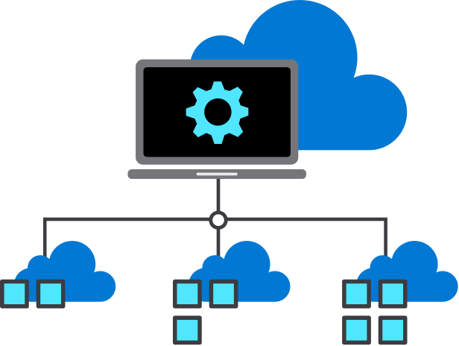
App Service, Cloud Functions
Use these fully managed platforms for apps. Runtimes for .NET, Node.js, PHP, Java, Python and more.
Less maintenance. No OS, no patching.
Deploy containers for applications.
Improved scale and integration with CI/CD tools.
Defaults that help improve reliability and security.
Manage CORS, SSL, DNS and more.
Notes:
Azure App Service is a fully managed hosting environment.
You put your app into App Service and Azure takes care of the rest. You don’t need an entire VM to run web apps. That is a massive waste of resources.
All you care about is the web hosting, so why not just pay for that piece?
Just like VM’s, scaling monitoring and backing up is no longer your problem.

Slide 22

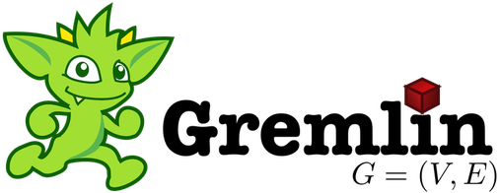
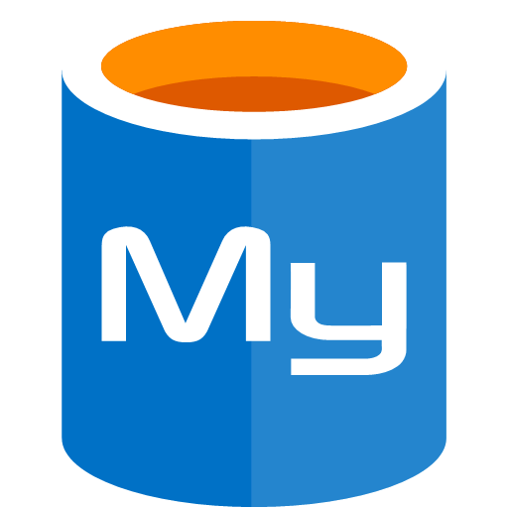
Database Services
Less maintenance. No OS, no patching.
Multiple options for different workloads (SQL, NoSQL, Document, Graph)
Multiple APIs based on your app requirements.
Ops tasks are managed. (Backups, Monitoring, Scale)
Notes:
Much like our App service is a hosted platform for our code, the Database as a Service options do the same for your data.

Slide 23


Network
Globally available Domain Name System (DNS).
Virtual networks with subnetting.
Content Delivery Network (CDN), Caching, Load Balancing, Firewalls.
Hybrid solutions to integrate with on-prem.
Azure SQL Database
Azure Storage
Subnet
Azure Virtual Network
Internet
Notes:
Now let’s take a look at Tailwind’s physical architecture and what services they can use on Azure to effectively migrate to the best possible solution.

Slide 24

Tailwind’s Approach
Let’s see what the team chose for the Tailwind Inventory Management System

Slide 25
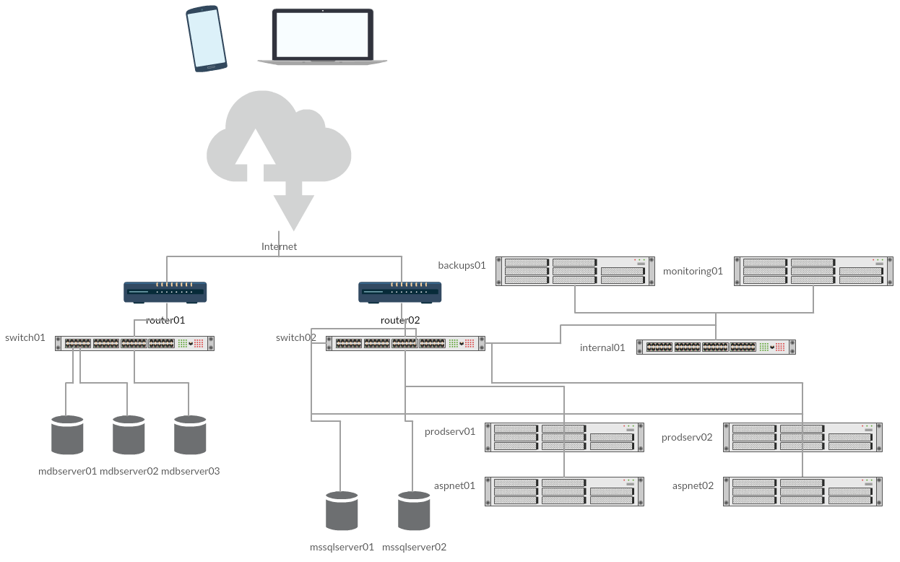
Internet
backups01
monitoring01
router01
router02
switch01
switch02
internal01
prodserve01
prodserve02
aspnet01
aspnet02
mdbserver01
mdbserver01
mdbserver01
sqlserver01
sqlserver02
Notes:
This is the current state of affairs.
Tailwind is hosting everything, so that requires them to have routers, switches, redundant databases (Mongo DB recommends 3), 2 SQL Servers, 2 API servers, 2 frontend services, along with a monitoring service to alert the oncall when something is down, as well as a backup system.
We have got to get all of this into Azure and it looks like a nightmare you would not want any part of.
But if we pick the right services in the cloud with the right knowledge of what is available, this gets drastically simpler.

Slide 26

Internet
backups01
monitoring01
Azure V Net
prodserve01
prodserve02
aspnet01
aspnet02
mdbserver01
mdbserver01
mdbserver01
sqlserver01
sqlserver02
Notes:
This is the current state of affairs.
Tailwind is hosting everything, so that requires them to have routers, switches, redundant databases (Mongo DB recommends 3), 2 SQL Servers, 2 API servers, 2 frontend services, along with a monitoring service to alert the oncall when something is down, as well as a backup system.
We have got to get all of this into Azure and it looks like a nightmare you would not want any part of.
But if we pick the right services in the cloud with the right knowledge of what is available, this gets drastically simpler.

Slide 27

Internet
backups01
monitoring01
Azure V Net
prodserve01
prodserve02
Cosmos DB
aspnet01
aspnet02
sqlserver01
sqlserver02
Notes:
This is the current state of affairs.
Tailwind is hosting everything, so that requires them to have routers, switches, redundant databases (Mongo DB recommends 3), 2 SQL Servers, 2 API servers, 2 frontend services, along with a monitoring service to alert the oncall when something is down, as well as a backup system.
We have got to get all of this into Azure and it looks like a nightmare you would not want any part of.
But if we pick the right services in the cloud with the right knowledge of what is available, this gets drastically simpler.

Slide 28

Internet
backups01
monitoring01
Azure V Net
prodserve01
prodserve02
Cosmos DB
SQL Server
aspnet01
aspnet02
Notes:
This is the current state of affairs.
Tailwind is hosting everything, so that requires them to have routers, switches, redundant databases (Mongo DB recommends 3), 2 SQL Servers, 2 API servers, 2 frontend services, along with a monitoring service to alert the oncall when something is down, as well as a backup system.
We have got to get all of this into Azure and it looks like a nightmare you would not want any part of.
But if we pick the right services in the cloud with the right knowledge of what is available, this gets drastically simpler.

Slide 29

Internet
backups01
monitoring01
Azure V Net
Cosmos DB
SQL Server
App Service
prodserve01
App Service
aspnet01
Notes:
This is the current state of affairs.
Tailwind is hosting everything, so that requires them to have routers, switches, redundant databases (Mongo DB recommends 3), 2 SQL Servers, 2 API servers, 2 frontend services, along with a monitoring service to alert the oncall when something is down, as well as a backup system.
We have got to get all of this into Azure and it looks like a nightmare you would not want any part of.
But if we pick the right services in the cloud with the right knowledge of what is available, this gets drastically simpler.

Slide 30
Internet
Azure V Net
Cosmos DB
SQL Server
App Service
prodserve01
App Service
aspnet01
Notes:
This is the current state of affairs.
Tailwind is hosting everything, so that requires them to have routers, switches, redundant databases (Mongo DB recommends 3), 2 SQL Servers, 2 API servers, 2 frontend services, along with a monitoring service to alert the oncall when something is down, as well as a backup system.
We have got to get all of this into Azure and it looks like a nightmare you would not want any part of.
But if we pick the right services in the cloud with the right knowledge of what is available, this gets drastically simpler.

Slide 31
Wrap up
Discussed cloud migration benefits
Reviewed migration options for the Tailwind Traders Datacenter hosted app to Azure!
Dipped into the current and planned architecture for Tailwind Traders app
Up Next: Overview of Database Migrations to Azure

